Slide 1



Wavecon Telecom 5G Analysis
Impact Of 5G Launch
Tirunagari Deepthi

Slide 2

Introduction Of Wavecon Telecom
Wavecon Telecom is a forward-looking telecommunications company delivering high-quality mobile and data services across diverse markets.
With the launch of 5G technology, Wavecon is strengthening its network capabilities to enable faster connectivity, advanced digital experiences, and sustainable business growth.

Slide 3

Business Objective
Wavecon Telecom launched 5G services in India in May 2022 across 15 major cities to deliver faster connectivity. This project analyzes the impact of the 5G launch on:
Revenue
Active users
Service plans
Objective: To assess business growth and customer adoption after 5G.

Slide 4
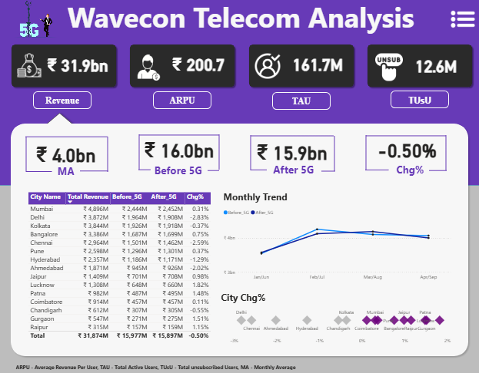
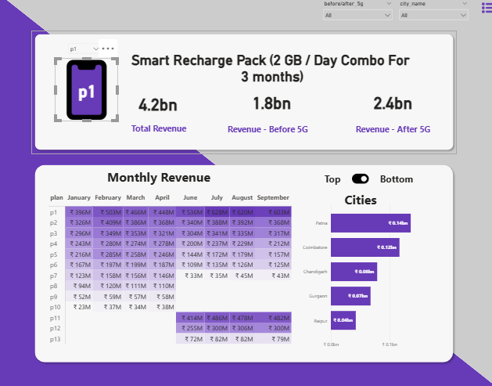
Performance Analysis Overview
Dashboard Scope:
The dashboard analyzes service plans and key business performance metrics.
Focuses on 4 critical KPIs to measure 5G impact:
  Revenue
  ARPU (Average Revenue Per User)
  TAU (Total Active Users)
  TUSU (Total Unsubscribed Users)
Time Period Covered:
8-month analysis window
  Before 5G: January to April
  After 5G: June to September
Purpose of Analysis:
To compare performance before and after the 5G launch
To understand trends in revenue, users, and customer behavior

Slide 5

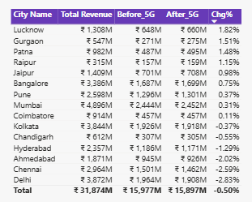
Key Findings
1. What is the impact of the 5G launch on our revenue?
Overall Revenue Change: −0.5% after the 5G launch
Before 5G: ₹15.98 bn
After 5G: ₹15.90 bn
Cities with Revenue Increase (%):
Lucknow: +1.82%
Gurgaon: +1.51%
Patna: +1.48%
Jaipur: +0.98%
Cities with Revenue Decrease (%):
Ahmedabad: −2.02%
Chennai: −2.59%
Delhi: −2.83%
Conclusion : Overall revenue declined slightly by 0.5%, with mixed city-wise performance showing both growth and decline after the 5G launch.

Slide 6
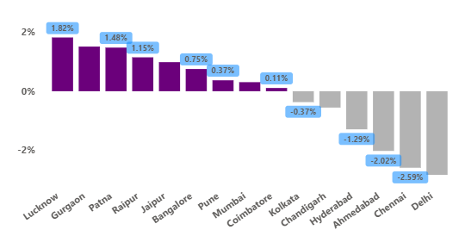
2.Which KPI is underperforming after the 5G launch?
Underperforming KPIs – Revenue, TAU, TUSU
💰 Revenue (Stable)
Before 5G: ₹15.97 bn
After 5G: ₹15.90 bn
Change: −0.50%
Insight: Overall revenue remained almost stable after 5G.
City Impact:
  Revenue Decline: Delhi (−2.83%), Chennai (−2.59%), Ahmedabad (−2.02%)
  Revenue Growth: Lucknow (+1.82%), Gurgaon (+1.51%), Patna (+1.48%)

Slide 7

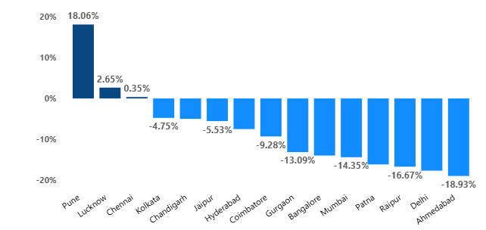
👥 TAU – Total Active Users (Underperforming KPI)
Before 5G: 84.4 M
After 5G: 77.4 M
Change: −8.28% (≈ 7M users lost)
Insight: Significant drop in active users after 5G launch.
Major Decline Cities:
  Ahmedabad (−18.93%)
  Delhi (−17.63%)
  Raipur (−16.67%)
  Patna (−16.11%)
Cities with Growth:
  Pune (+18.06%)
  Lucknow (+2.65%)
  Chennai (+0.35%)

Slide 8

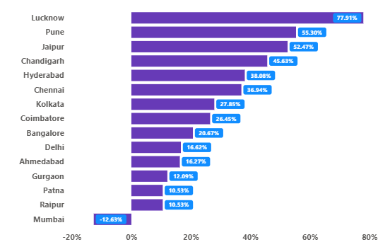
🚪 TUSU(Total Unsubscribed Users) - Increased
Before 5G: 5.6 M
After 5G: 7.0 M
Change: +23.5%
Insight: Sharp increase in customer unsubscriptions
post-5G.
High Unsubscription Cities:
Lucknow (+77.91%)
Pune (+55.30%)
Jaipur (+52.47%)
Chandigarh (+45.63%)
Overall Conclusion : Revenue remained stable, but user retention weakened after 5G, making TAU the most impacted KPI.

Slide 9
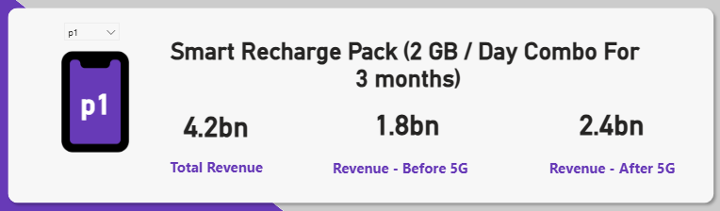

3.After the 5G launch, which plans are performing well in terms of revenue? Which plans are not performing well?
Plan Performing Well After 5G Launch – P1
Revenue for Plan P1 increased around 31.66% after 5G launch

Slide 10
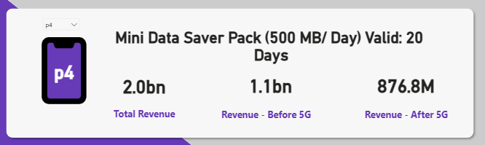
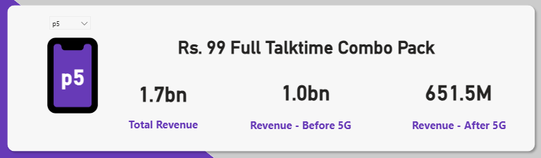
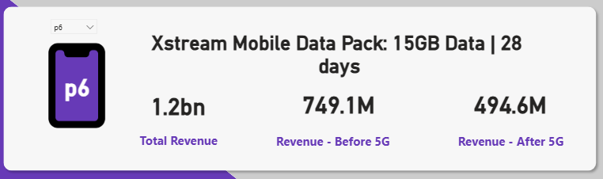
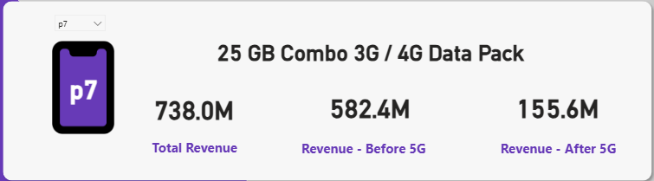
Plans Not Performing Well After 5G Launch – P4, P5, P6, P7
Revenue for Plan P4 Declined around 18.47% after 5G launch
Revenue for Plan P5 Declined around 35.15% after 5G launch
Revenue for Plan P6 Declined around 33.97% after 5G launch
Revenue for Plan P7 Declined around 73.28% after 5G launch

Slide 11
4.Is there any plan affected largely by the 5G launch? Should we continue or discontinue that plan?
🚨 Most Affected Plan – P7:
25 GB Combo 3G / 4G Data Pack
Revenue Before 5G: ₹582.4M
Revenue After 5G: ₹155.6M
Revenue Decline: −73.28%
Key Insight:
The 5G launch significantly reduced demand for legacy 3G/4G data plans, as customers shifted toward high-speed 5G-enabled offerings.
Recommendation:
Discontinue or redesign Plan P7 by upgrading it to a 5G-compatible plan or replacing it with a higher-value data bundle.

Slide 12
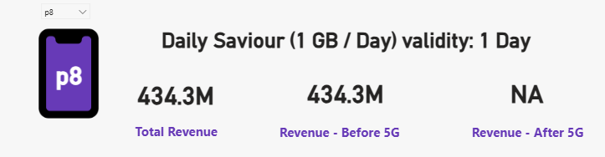
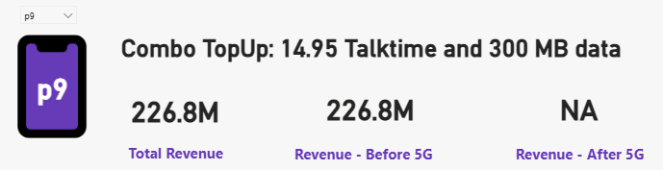
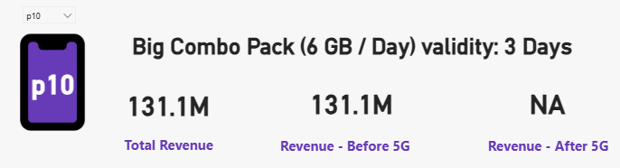
5.Is there any plan that is discontinued after the 5G launch? What is the reason for it?
Revenue only before 5G: ₹434.3M
No revenue after 5G
Indicates complete drop in demand post-5G due to very low data offering.
Revenue only before 5G: ₹226.8M
No revenue after 5G
Low data and voice-focused plan not aligned with 5G usage patterns.
Revenue only before 5G: ₹131.1M
No revenue after 5G
Short validity and limited relevance in a post-5G high-usage market.

Slide 13
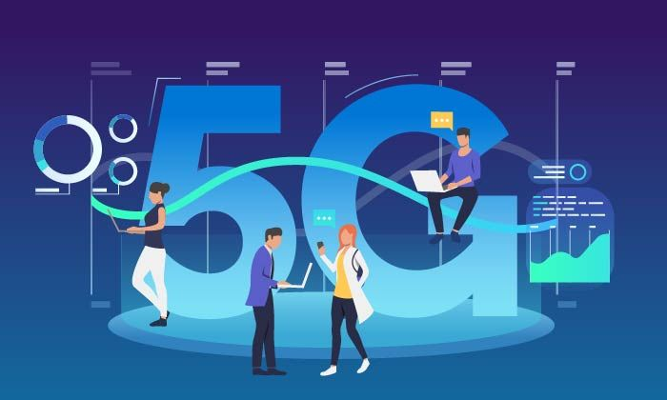
Thank You

